Slide 1
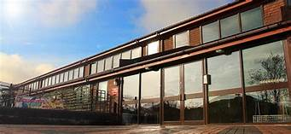


Welcome to Hurst Hill Primary
You will be joining our Nursery class.
We are very excited to meet you!
This is our main school entrance. Here you will find Miss Blaze and Mrs Darrell- our school admin team. They will help with any enquires.
Our school forms part of the Hales Valley Multi Academy Trust
This is our school logo

Slide 2
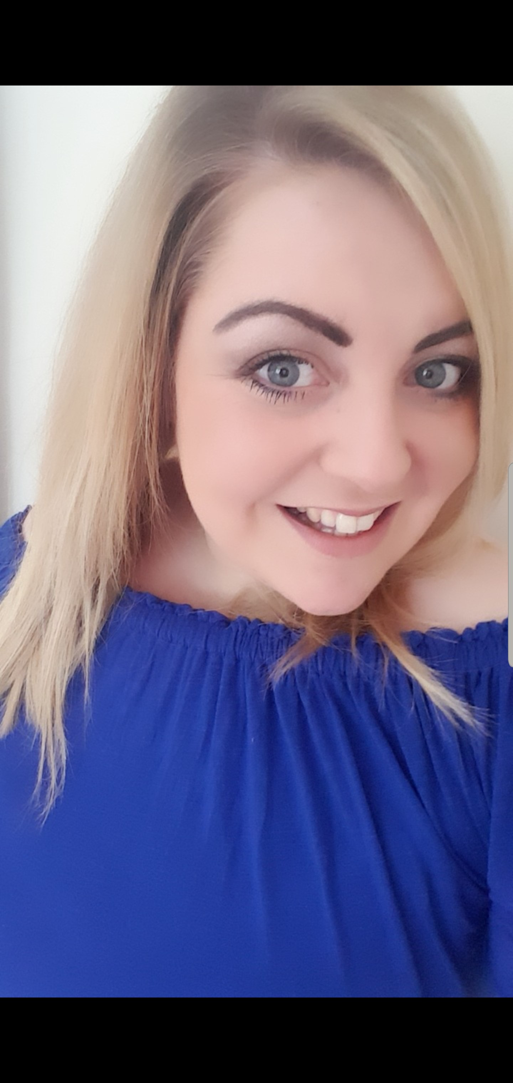
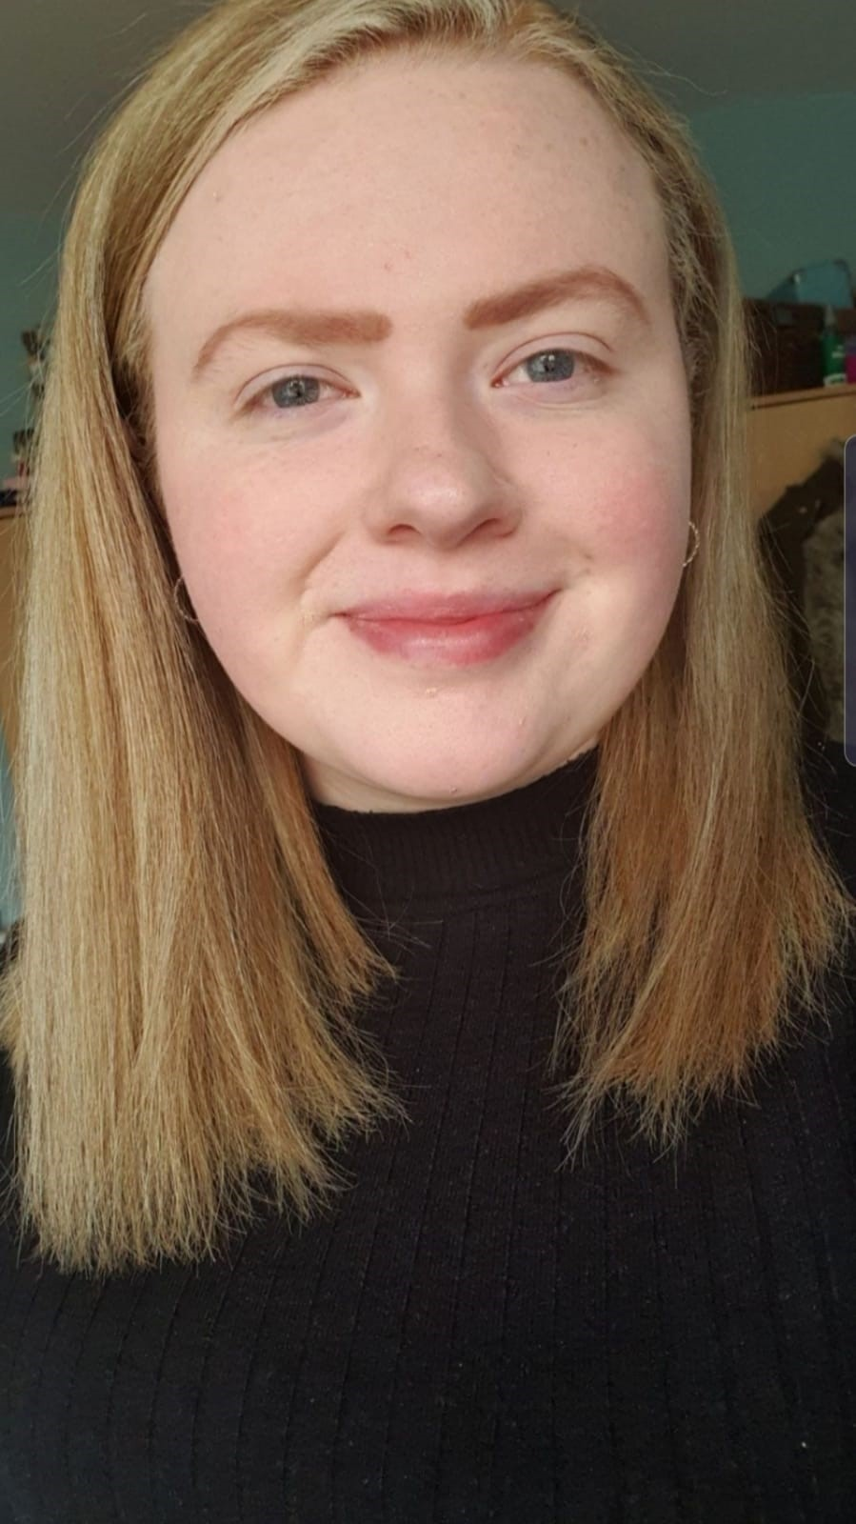
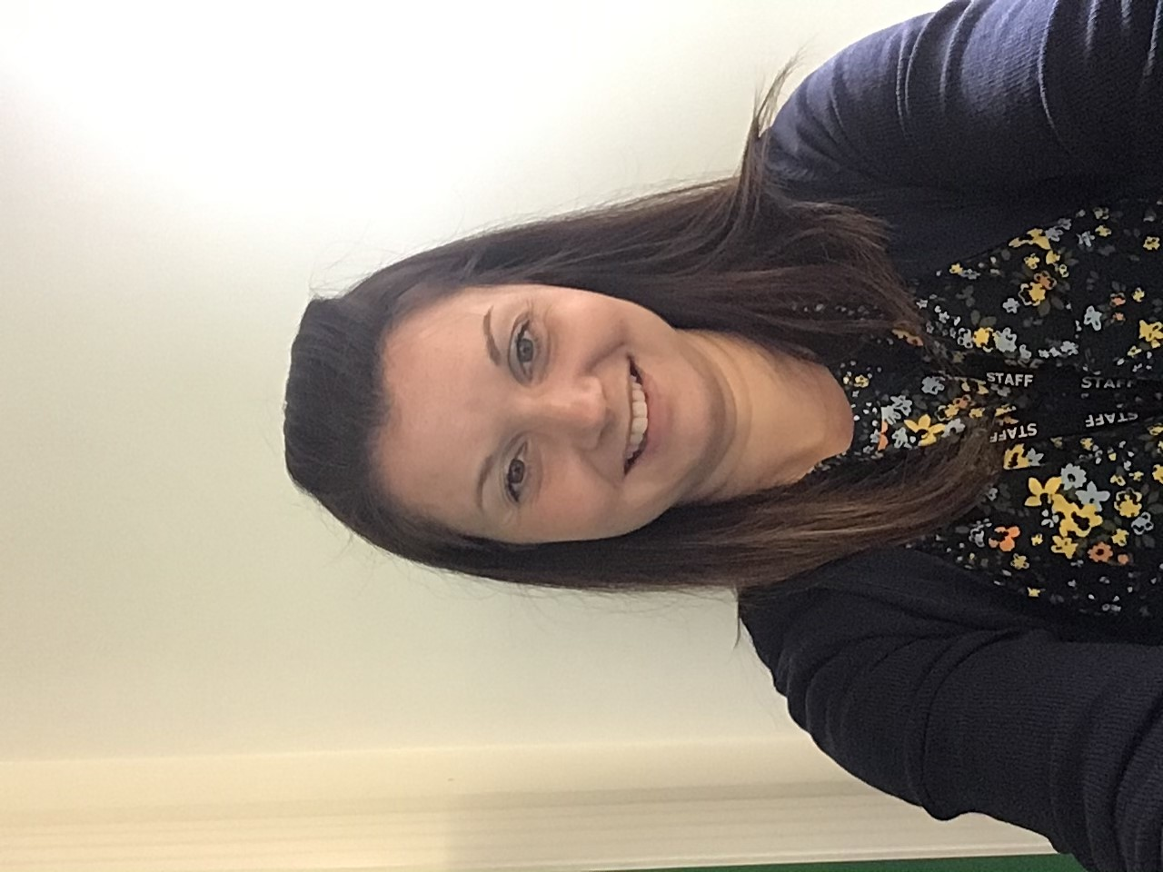
Our Nursery Team
You will see these teachers every day, they will support you to learn new things. At different times of the day you will go into small groups to complete activities with your key person. Parents will be informed of their child’s key person when they have completed their settling in period.
Miss J Morgan
Nursery Manager
Mrs C Norwood
Nursery Practitioner
Miss G Oliver
Nursery Practitioner
(Mornings only)

Slide 3
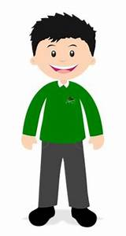
Nursery Uniform
Please ensure that all clothing that your child wears or brings into school, is clearly labelled with your child’s name and class.
We like our children to wear a school uniform in Nursery.
Uniforms are stocked at the Uniform shop on Bilston indoor Market. However, in Nursery children can wear plain green school wear which can be purchased from Super markerts.
Children will start Nursery in their Winter uniform:
Green or White polo shirt and grey pinafore, skirt or long tailored trousers., we do also allow children to wear black or grey jogging bottoms or leggings in Nursery.
Green cardigan or sweatshirt.
Suitable footwear – children in Nursery can wear trainers or pumps if preferred.
No jewellery to be worn at school except for a pair of stud earrings.
We accept no responsibility for the loss of jewellery worn against our advice.
Wellies - They will also need a pair of wellies for the outdoor environment.

Slide 4
Early Years Curriculum
Activities in Nursery are carefully planned and organised in order to provide a range of learning experiences.
Planning for each week is carried out using a topic-based approach, following the children’s interests and individual needs, and responding to specific events.
There are 7 Areas of Learning in the Early Years Foundation Stage (EYFS):
Personal, Social and Emotional Development
Physical Development
Communication and Language
Literacy
Mathematics
Understanding the World
Expressive Arts and Design
Throughout the EYFS, children will be working towards the Early Learning Goals. These describe the level of attainment expected at the end of your child’s Reception year in school.

Slide 5
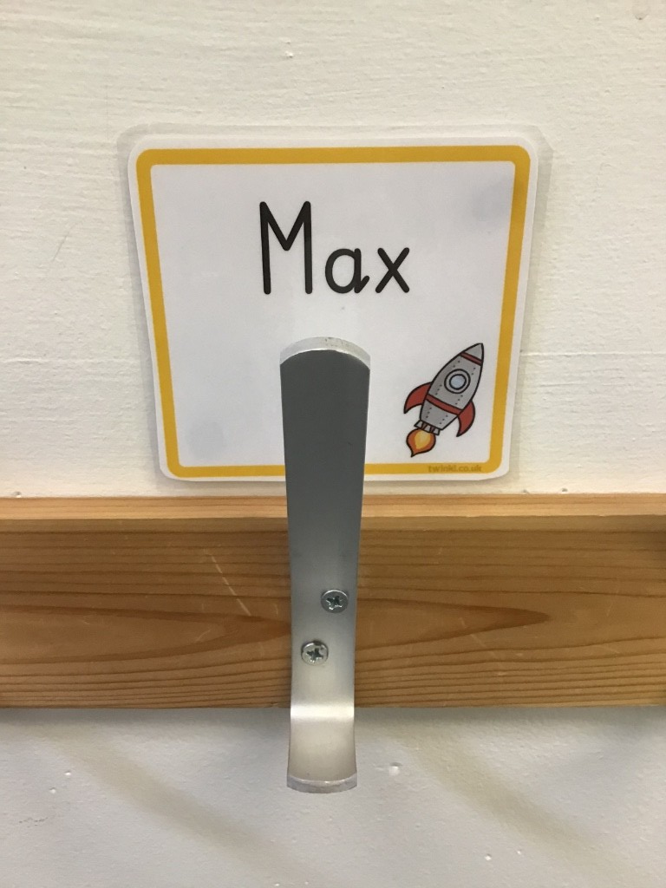
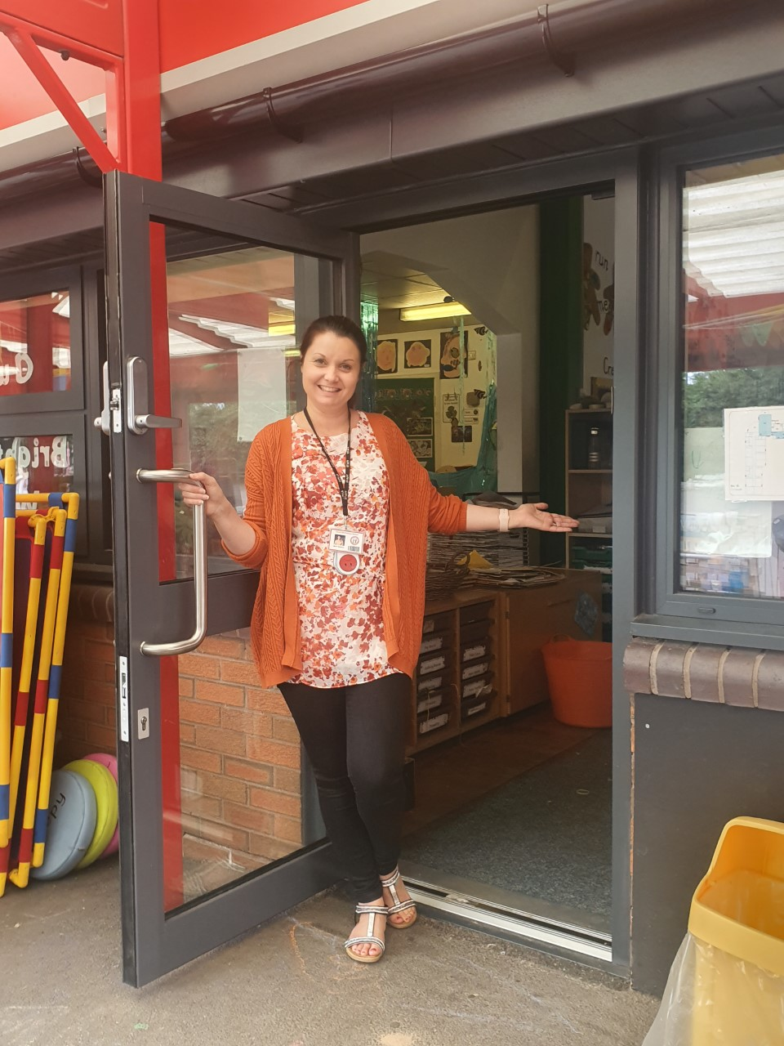
You will arrive and leave Nursery through this door…
You will have your own peg with your name on. This is where you will hang your coat and bag.

Slide 6
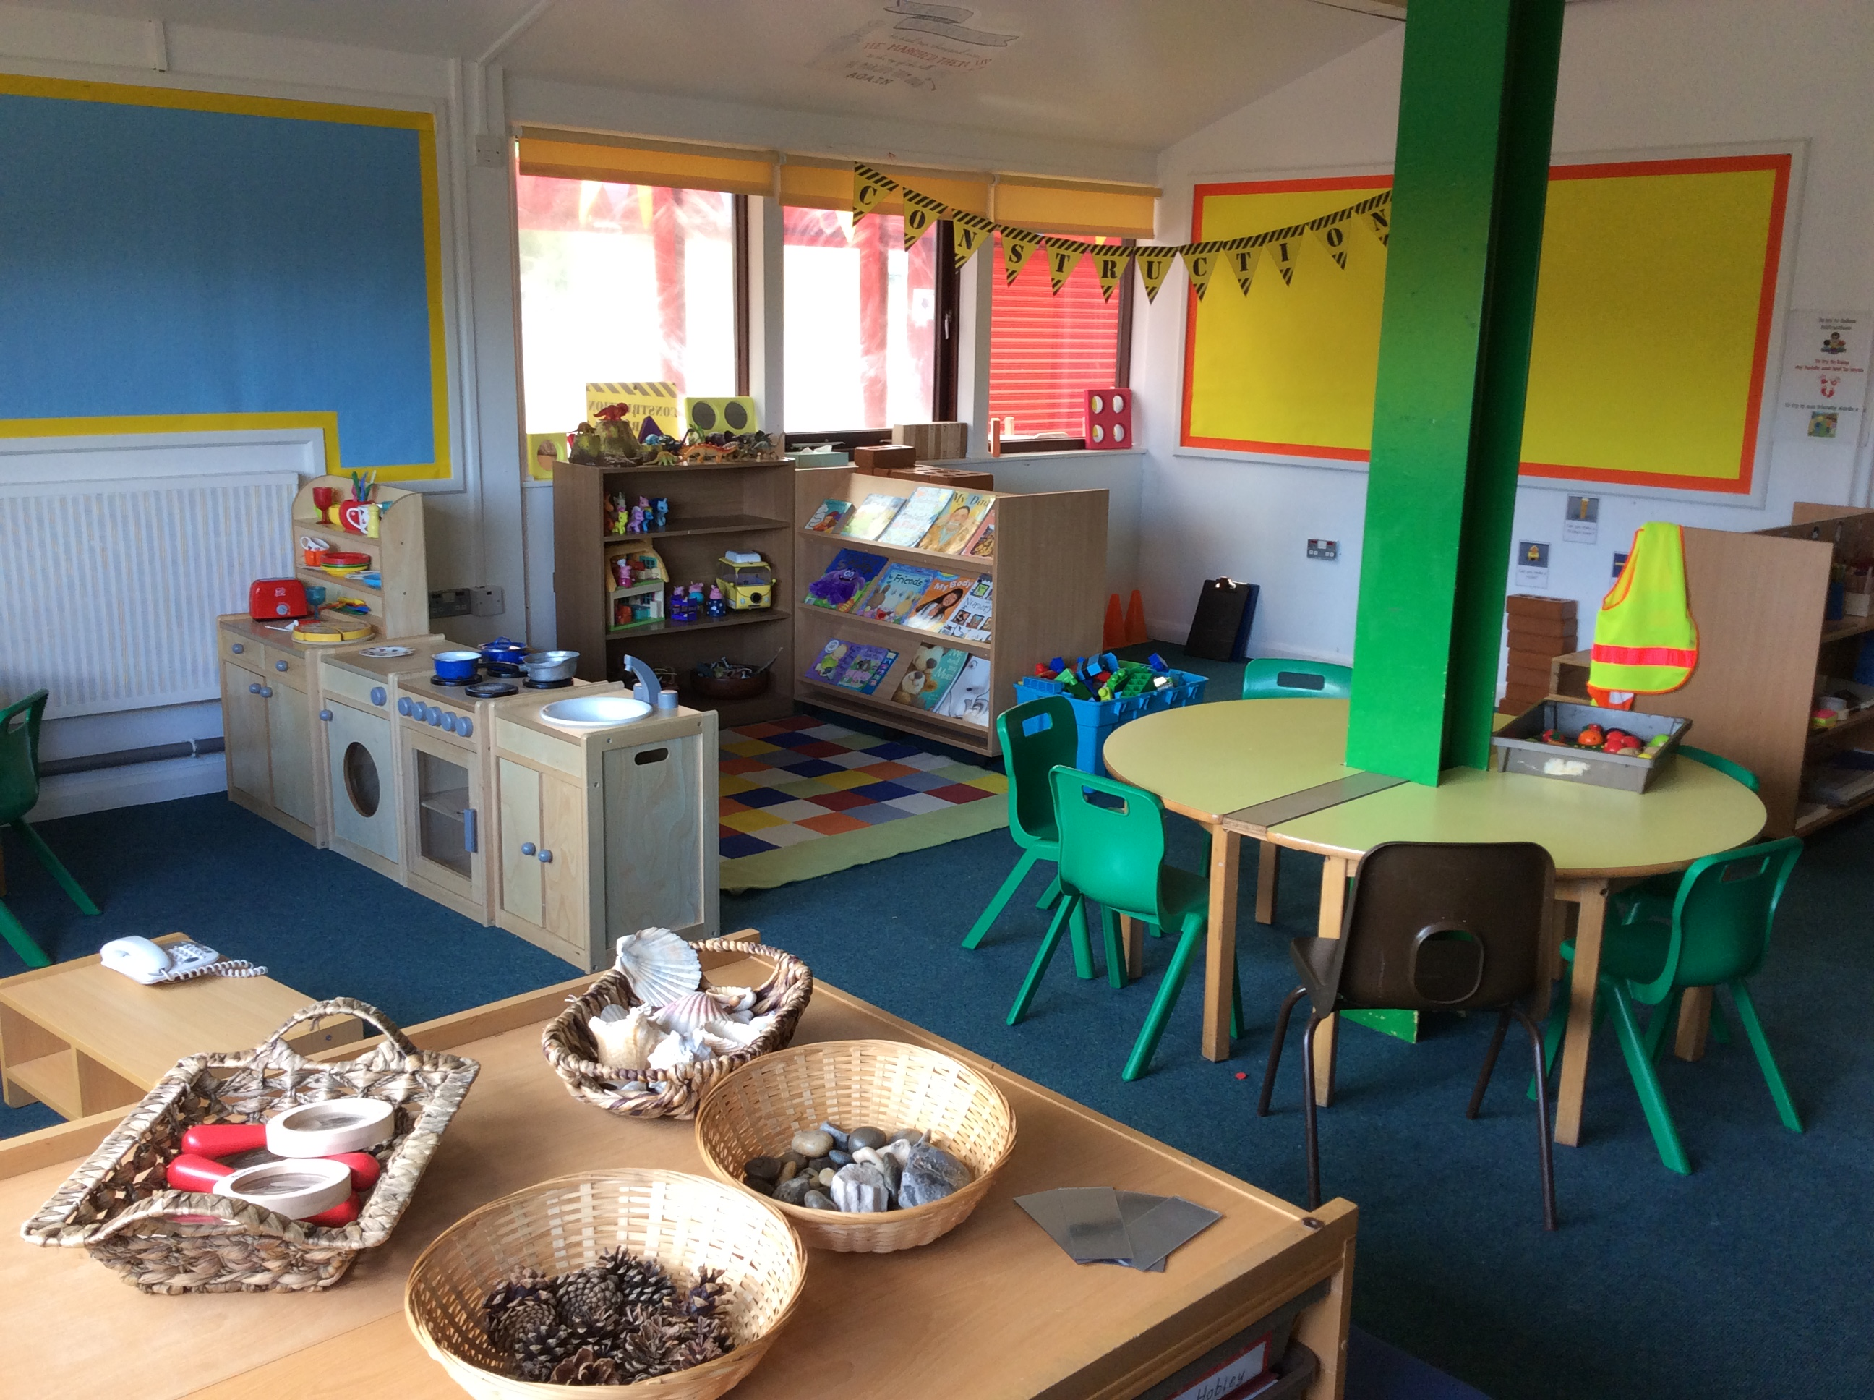
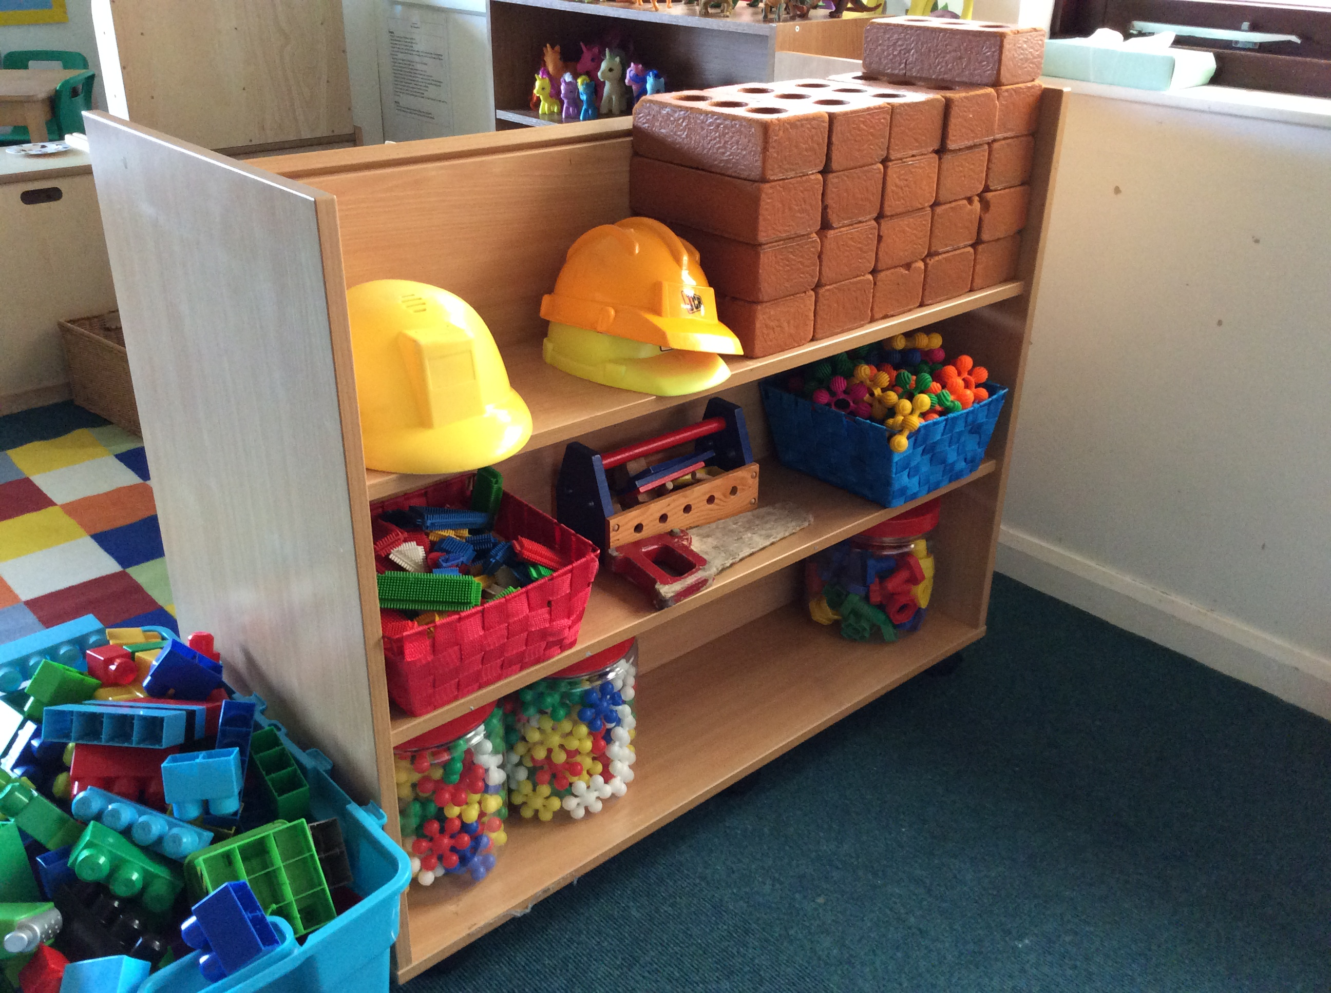
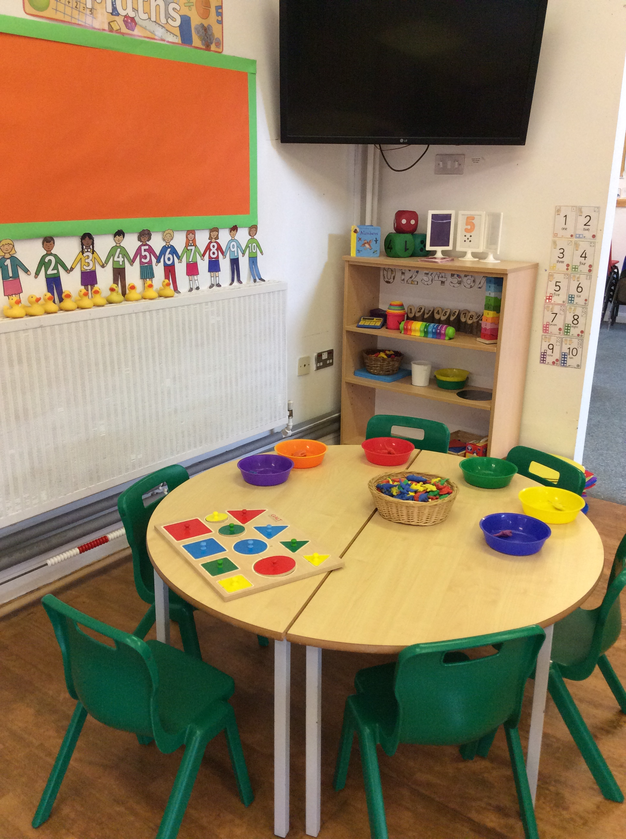
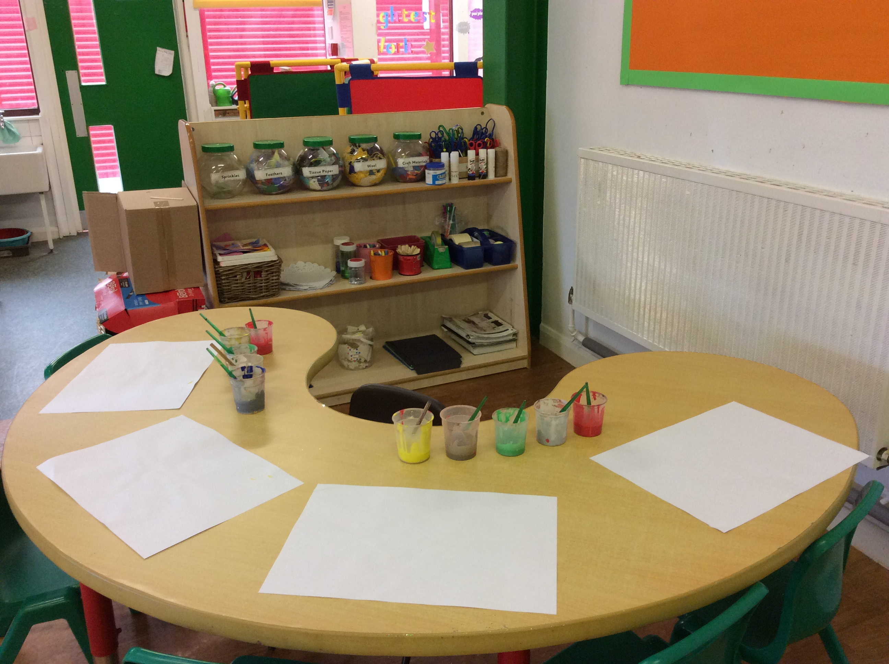
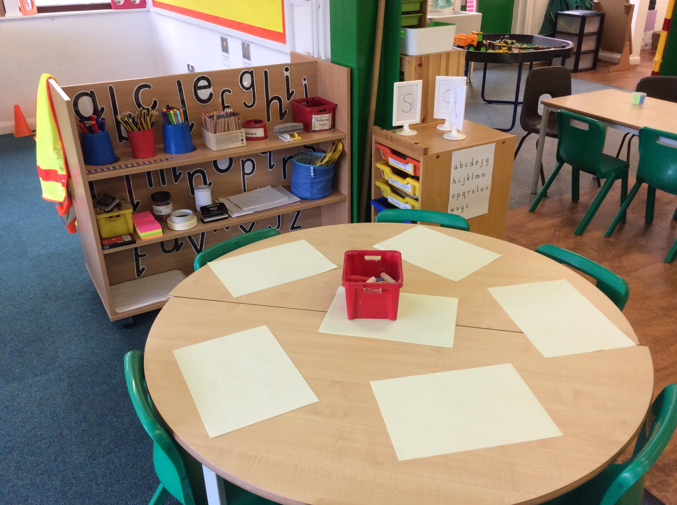
Inside the Nursery Classroom

Slide 7





Our Nursery Sessions
We begin our session with a ‘Dough disco’, where the children follow different movements using playdough which helps to develop their fine motor skills.
The children take part in an adult-led phonics sessions which focus on speaking and listening skills. They will access phonics as a key group, this will help to build confidence and self-esteem.
During each session we enjoy a healthy snack of fruit or veg and milk or water. We sit at tables to have snack and enjoy developing our discussion skills with our friends and adults.
If you stay for lunch, we eat in the dining hall and then come back to Nursery for our afternoon session where we will take part in a range of adult led and child led activities
We have daily adult led math’s activities within our key groups, small group work and independent activities. Once a week we also take part in a P.E session.
Throughout the day the children take part in various child-initiated learning sessions which are themed and led by the children’s own interests. During this time they are free to choose what they want to do, such as accessing different resources in both our indoor and outdoor classrooms

Slide 8
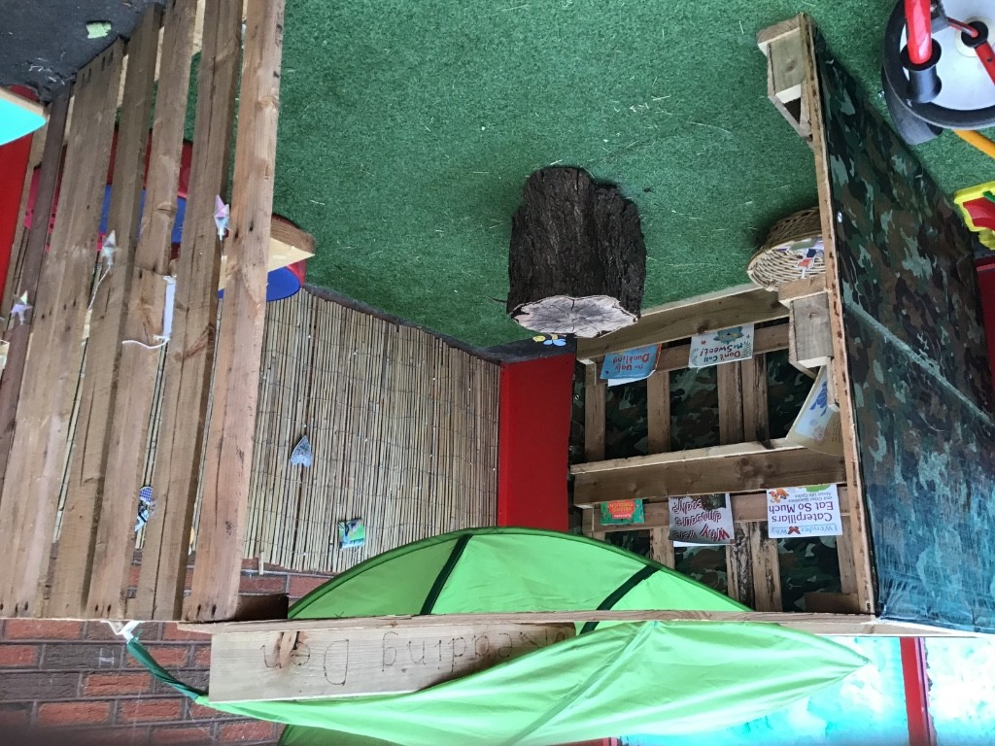
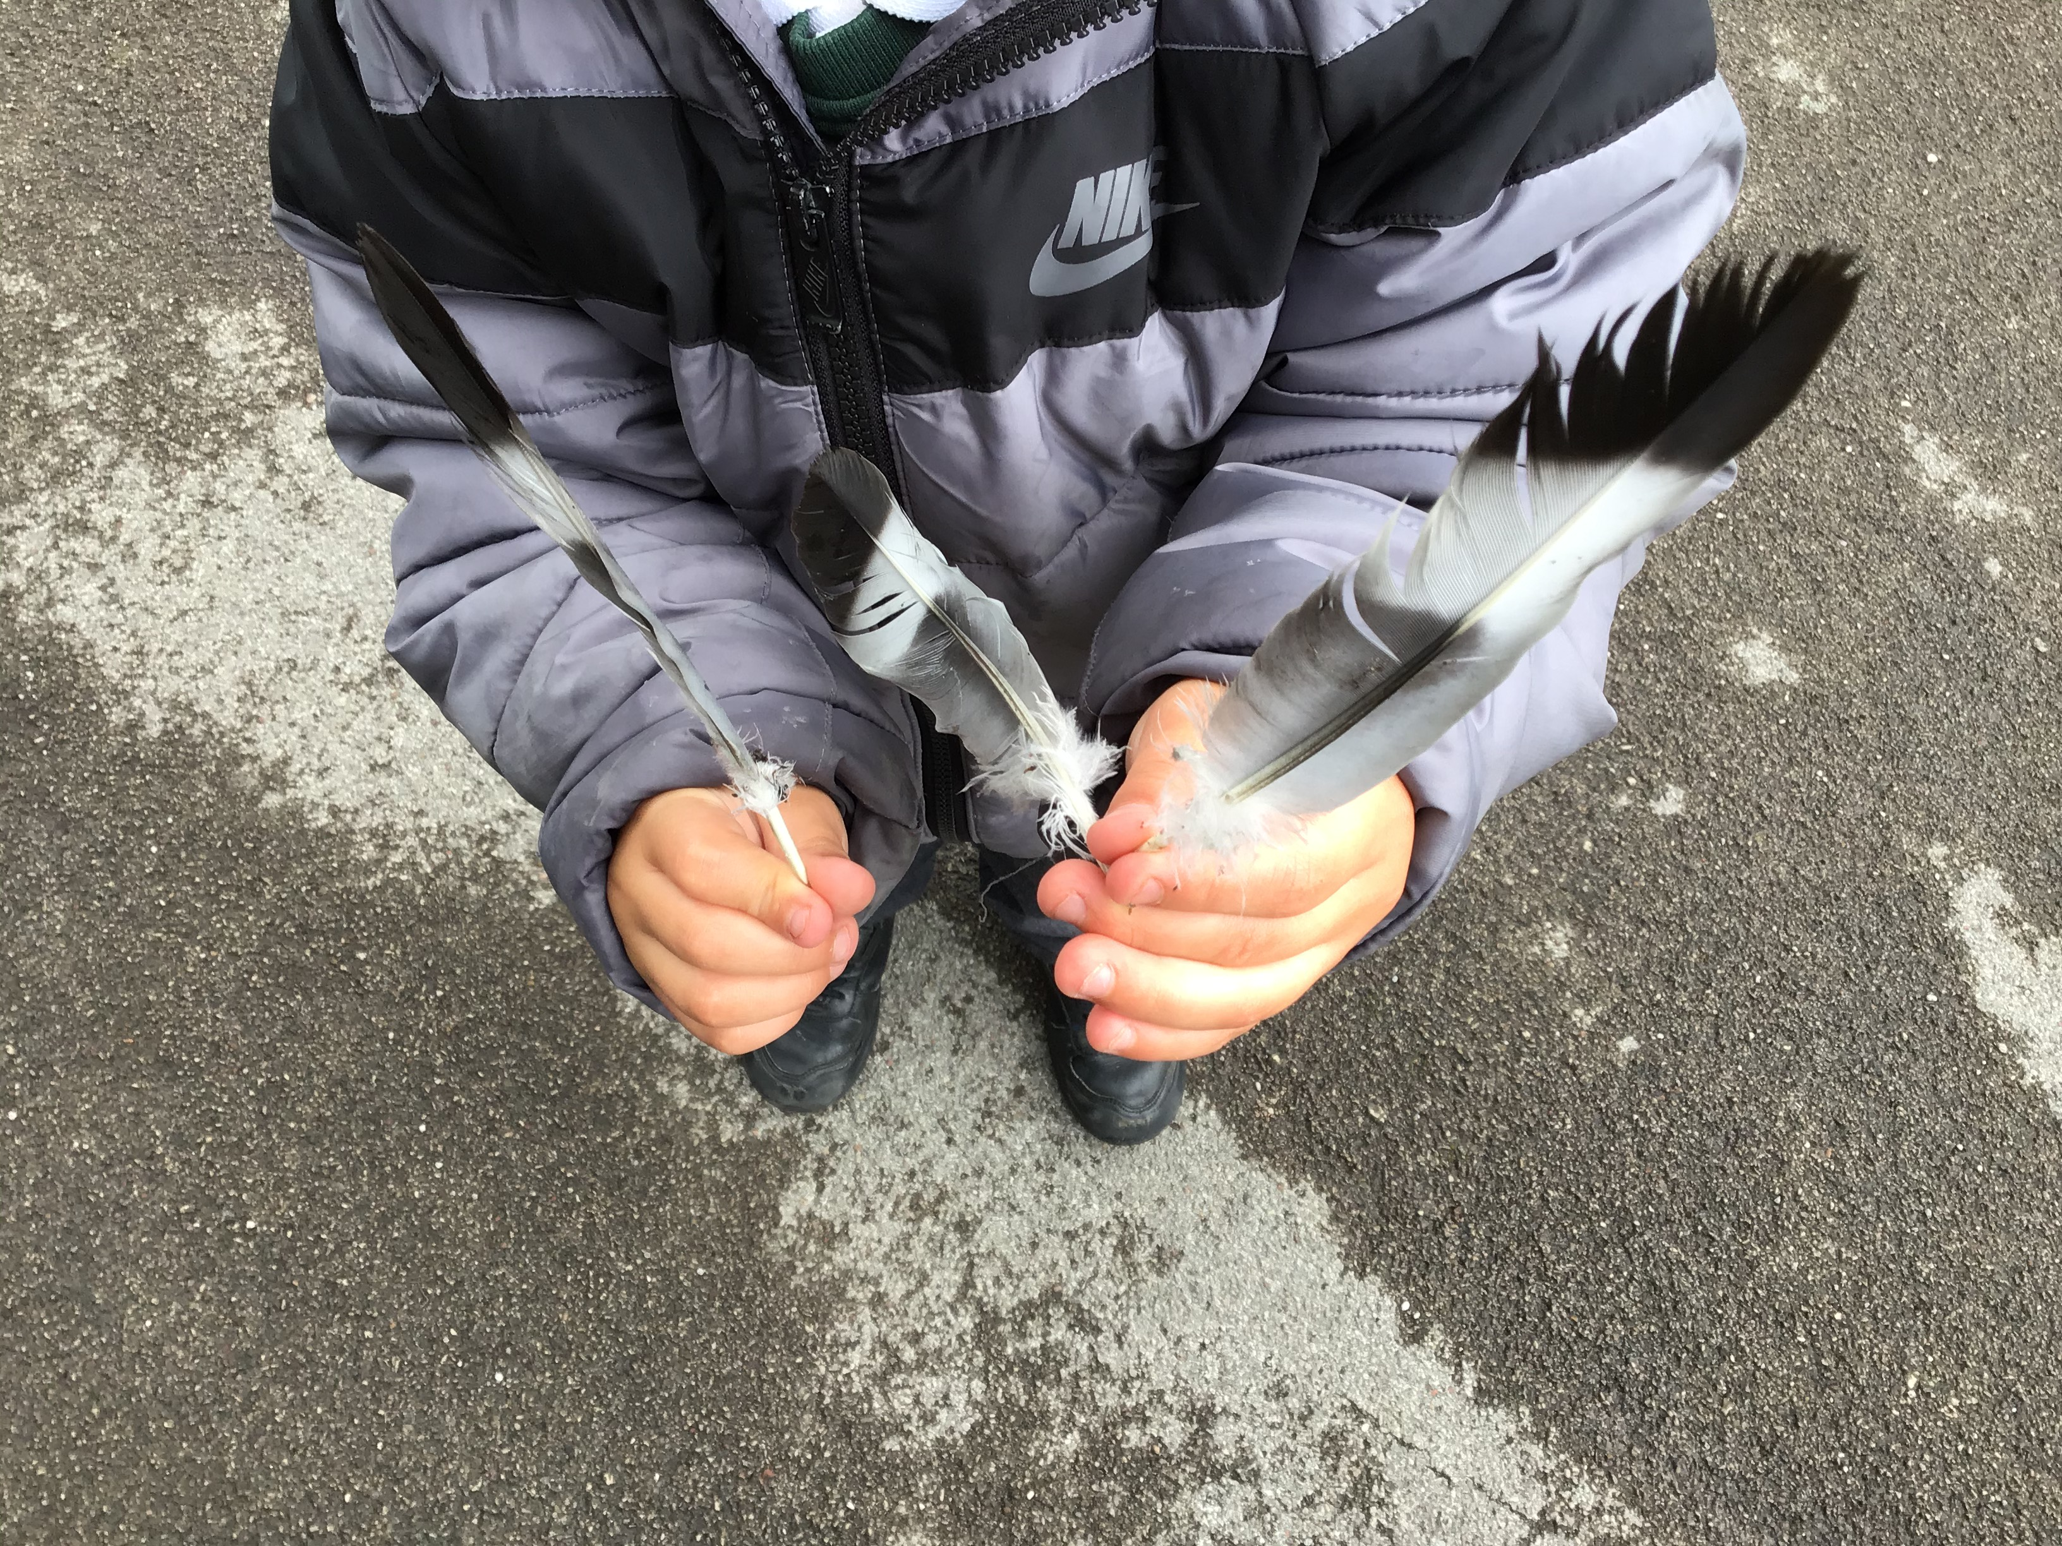

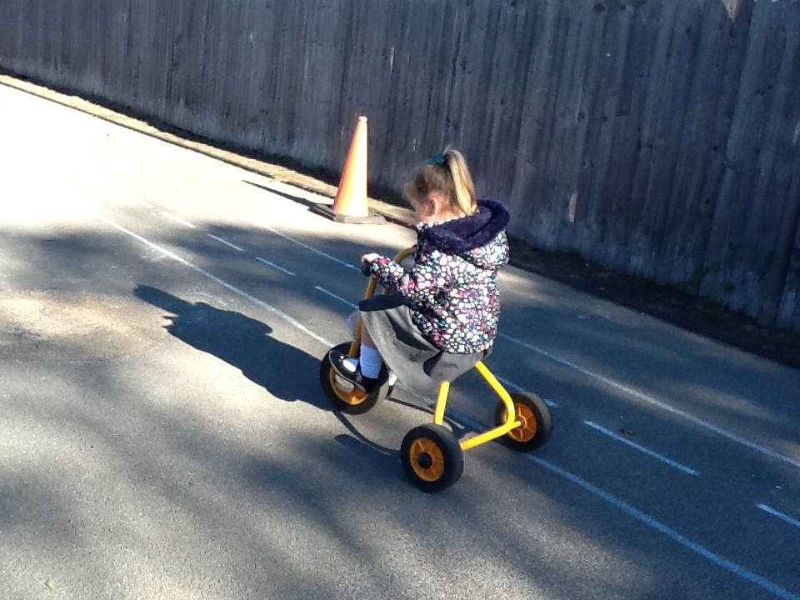
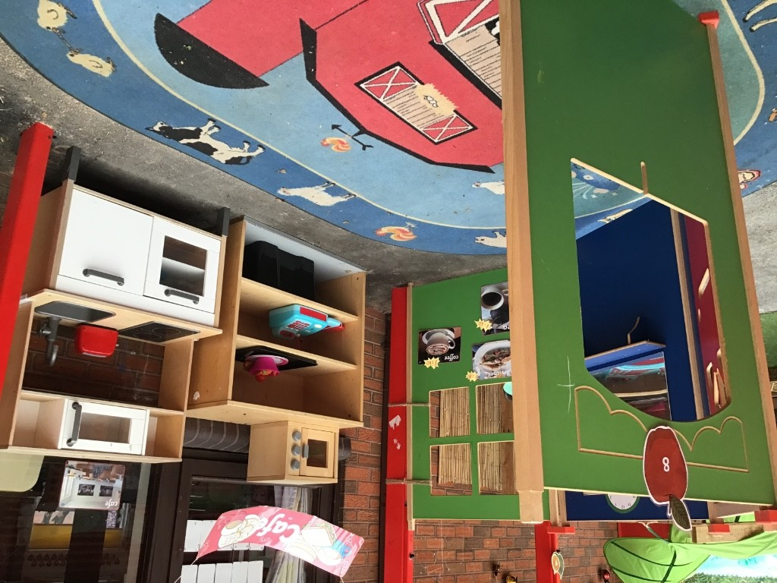

Learning outdoors
We will be going outside everyday - so remember your coat and wellies

Slide 9
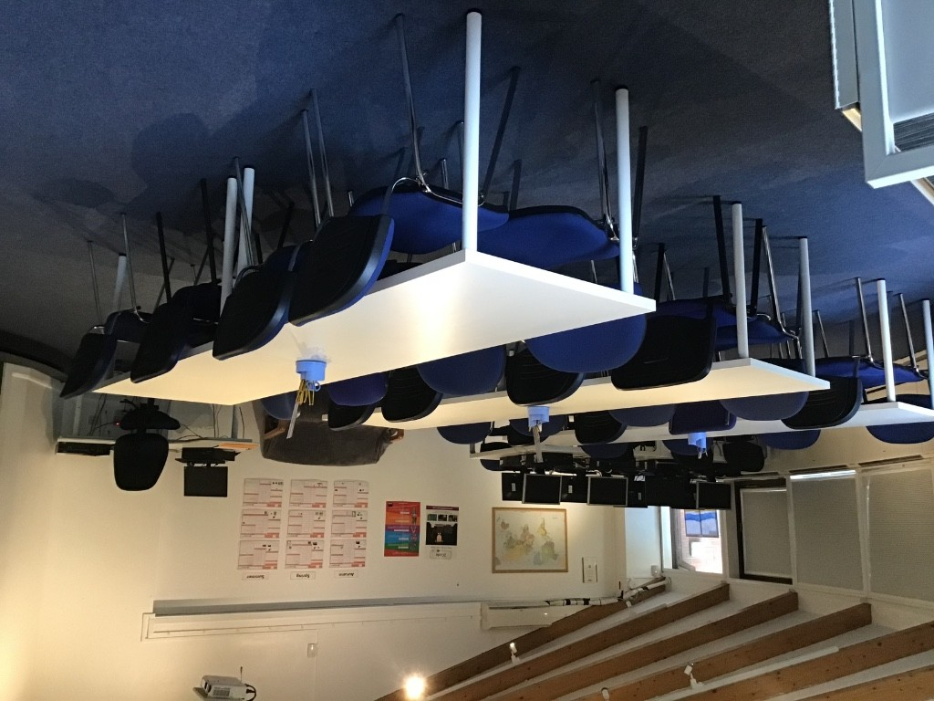
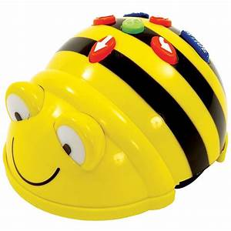
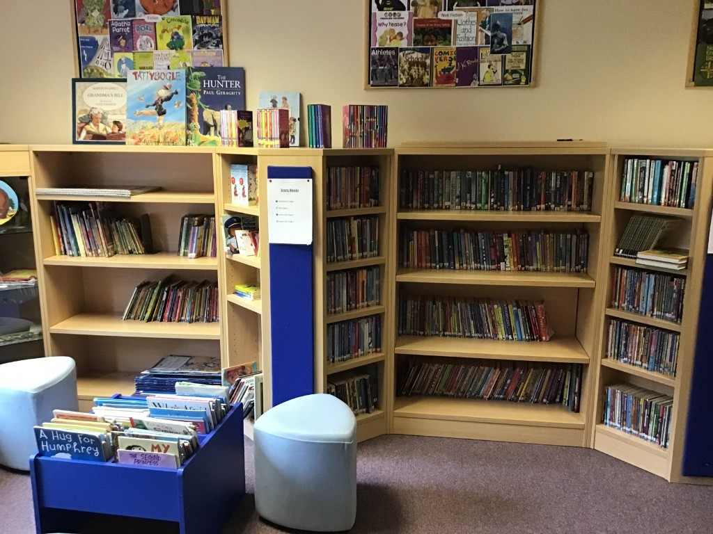
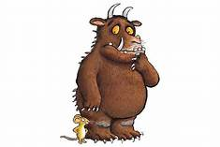
Tech Central
We will visit here to learn about Technology
Library
We will visit here to look at books and share stories

Slide 10

Food and Drink
Lunch: If your child is entitled to 30hours provision they will have their lunch in the school hall. If you would like your child to have a school lunch then please send in £2.40 in a named envelope. There are 5 choices every day including sandwiches, wraps, jacket potato and two further hot meals. Alternately, you can send in a packed lunch for your child.
Snacks: Children will receive fruit and milk during the day.
Drinks: Water is available throughout the day, including lunchtimes. Children can also bring a drink to school – only water is allowed.
Please ensure that your child’s drinks bottle is labelled with their name.

Slide 11
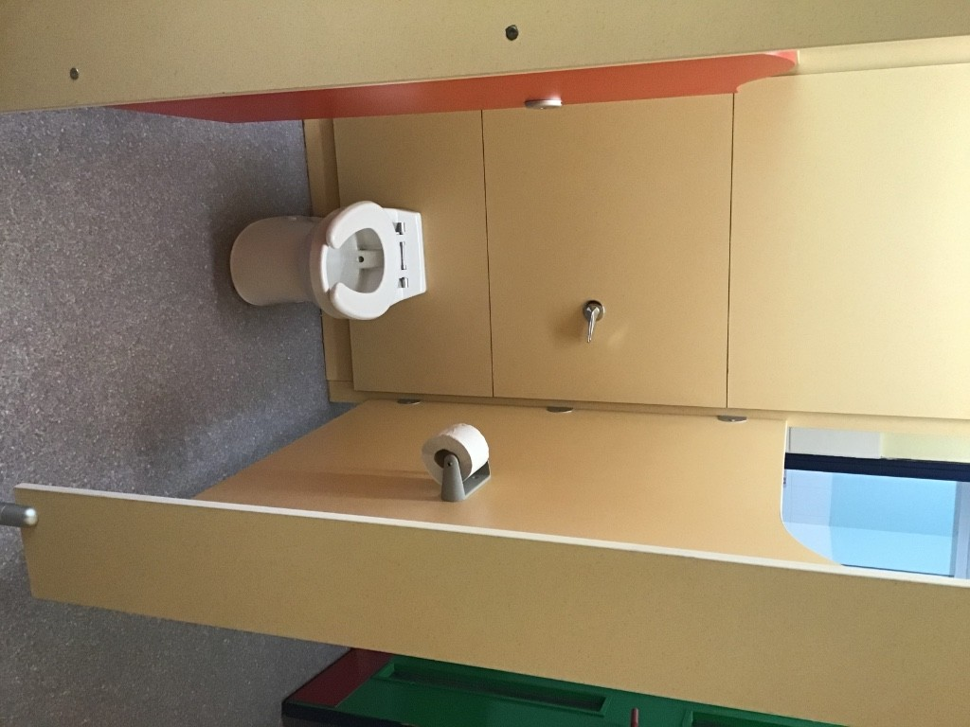
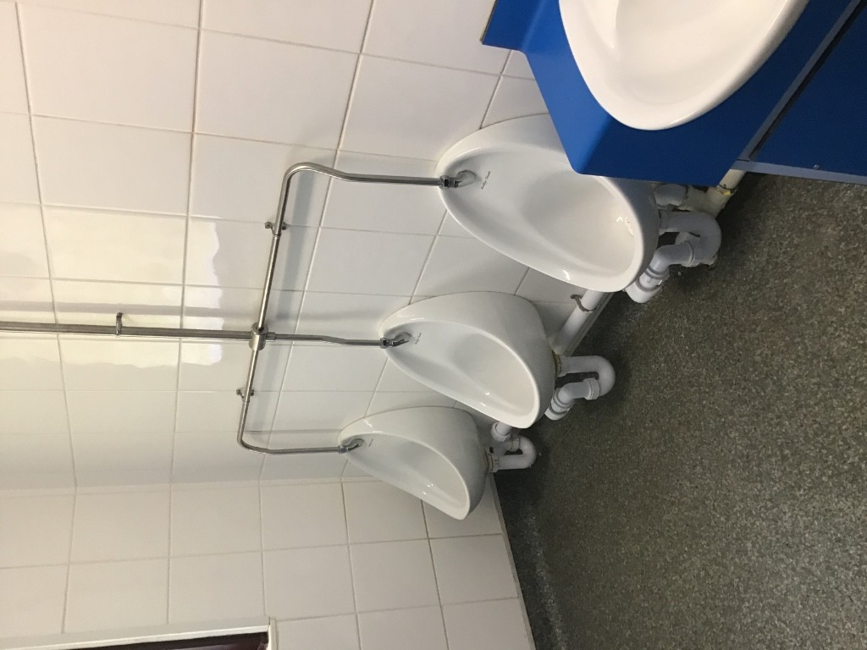
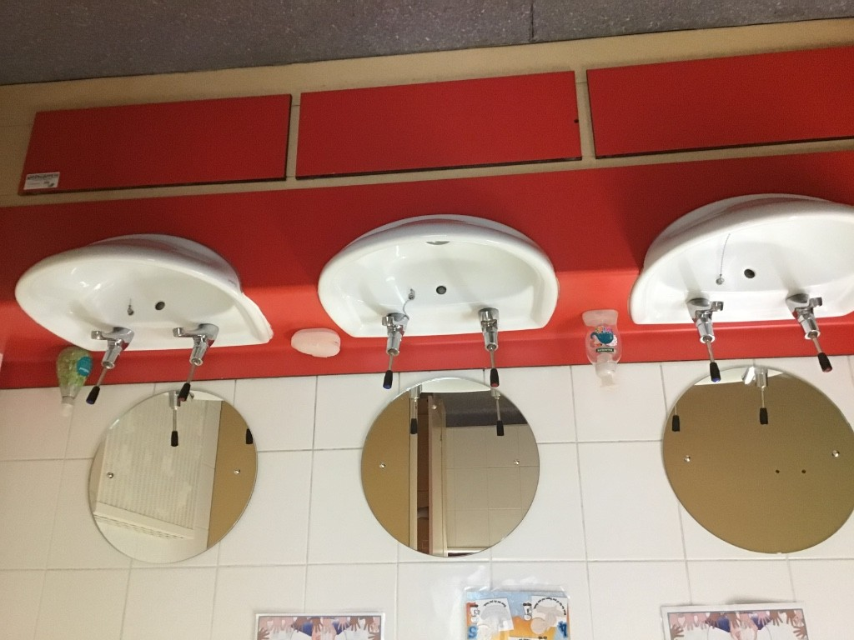


This is our Nursery
bathroom.
It is important that you remember to wash your hands.

Slide 12

Nursery Contribution Fund
At Hurst Hill we strive to deliver extra experiences that children may not otherwise take part in. Some of these may be cooking, food tasting, dressing up days or annual celebrations. To help towards the cost of extra resources purchased for these experiences, we kindly ask for a small donation of £5 per term towards our Nursery Contribution Fund.
This will be payable at the start of each term, or £15 for the full year.

Slide 13


Nursery Transition
Due to Covid-19 we have had to take a slightly different approach to our Transition period.
We will be offering a ‘doorstep’ home visit where we will meet you and your child and deliver your Home Visit Pack.
Children will have a staggered start to Nursery to help them settle in.
If you have not received your letter about your doorstep home visit please contact us ☺

Slide 14

Things to remember for your child’s Nursery days
My child’s belongings are all labelled with their full name
My child has a full set of spare clothes including pants and socks in their bag
My child has a supply of nappies and wipes in their bag (if required)
I have completed all Registration forms
I have paid/provided lunch for my child (30hours child)
I have paid £5 towards the Nursery Contribution Fund
I have discussed and provided any medication required for my child

Slide 15






Stay connected
There are a number of ways of keeping up to date when joining the Hurst Hill community.
Parents will receive all school information via Parent Mail
I.e. Letters, Newsletters, reminders etc
Visit our school website
www..hursthillprimaryschool.com
Parents will be able to view
observations that staff make. You are also able to add your own
contributions about learning at home.
You could join our PTFA and support our school
Follow us on social media
Facebook– Hurst Hill Primary School
Twitter- @HurstHillTweets

Slide 16
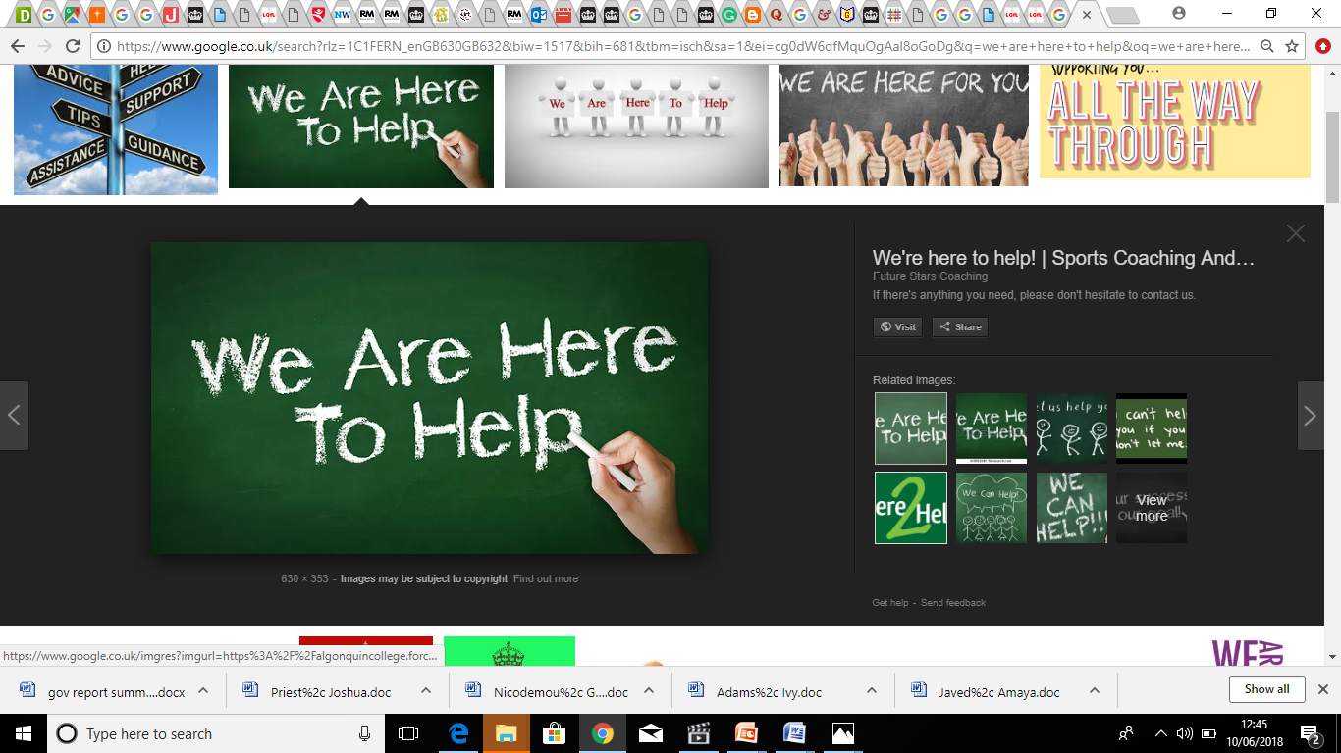
We hope that this information is useful. Should you have any questions, please feel free to email info@hurst-hill.dudley.sch.uk
or call the school office direct on
01384 818845
We aim to ensure that your children’s experience in Hurst Hill is a happy and rewarding one. We look forward to working with both you and your children.

